Slide 1
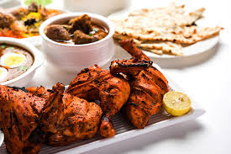
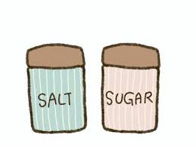
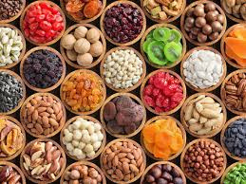
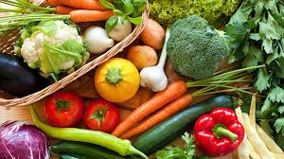

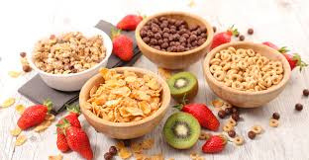
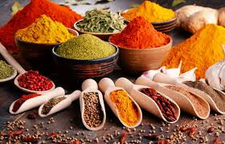
NOV 25
CATEGORY ANALYSIS
Author: Rudra Prasad Bhuyan
Position: Data Scientist Intern
Organisation: SBC Labs
Guidance: Anushka Ashok, Alok Gangaramany

Slide 2


ABOUT
Category Analysis helps us understand how users spend their money, both in terms of quantity and value.

Slide 3



Map the item code based on the questionnaire, then group by the desired category, taking into account of total consumption quantity & Value. Then plot the bar and KDE graphs.
THE PROCESS

Slide 4
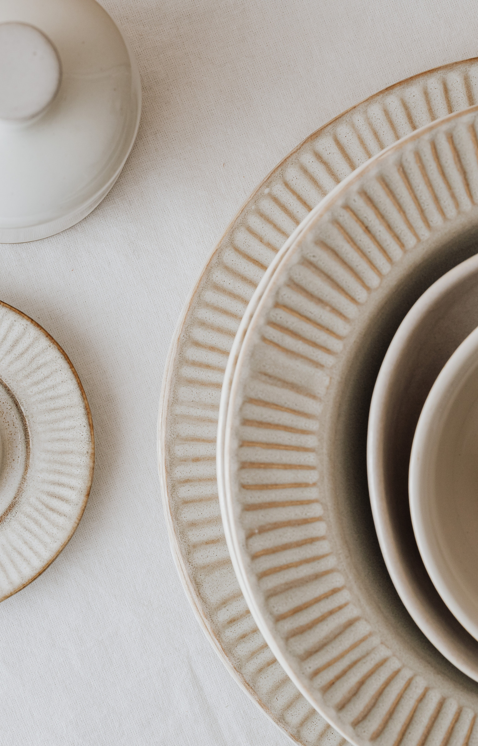
WHAT WE DO
- Category-wise
- Distribution and frequency
- Per Category item purchase

Slide 5

ANALYSIS
12
MOST PURCHASE
CEREALS
MilK PRODUCT
VEGETABLES
Category

Slide 6
category

Slide 7
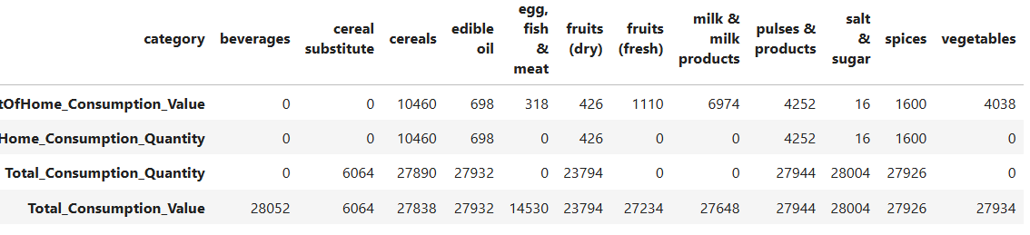
table

Slide 8
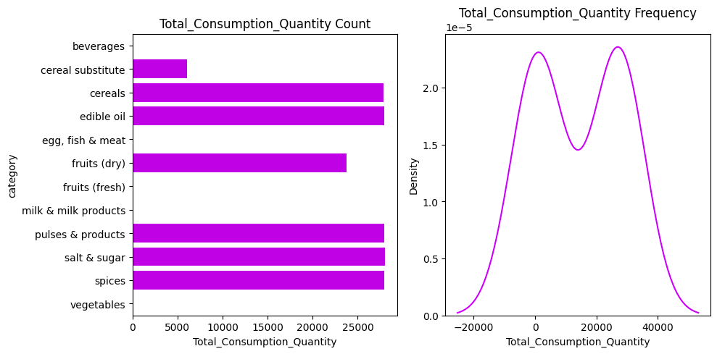
Category Total Quantity

Slide 9
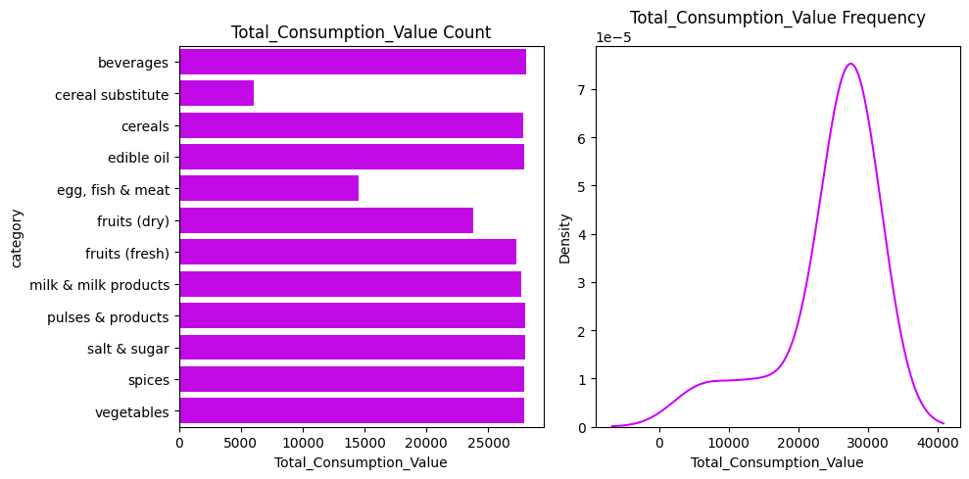
Category Total Value

Slide 10
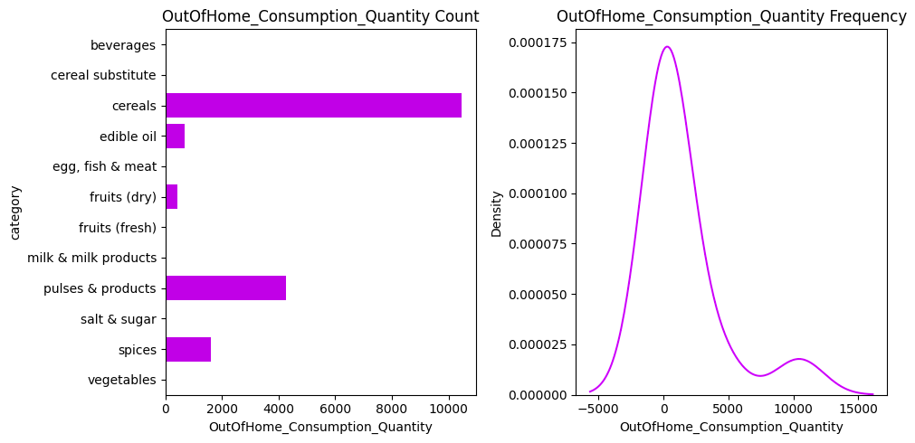

out of home Category Total quantity

Slide 11
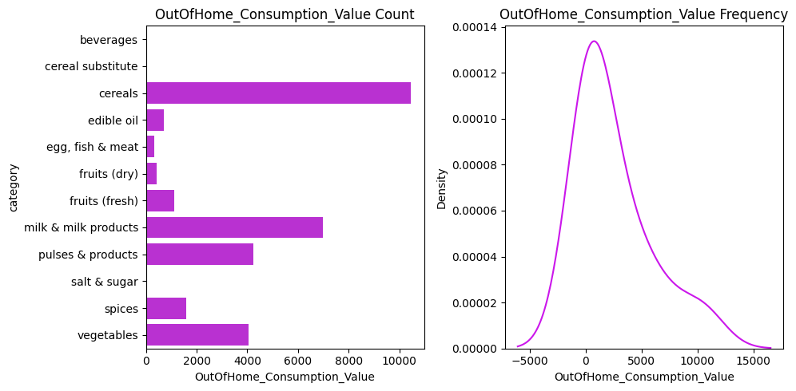
out of home Category Total value

Slide 12

beverages

Slide 13
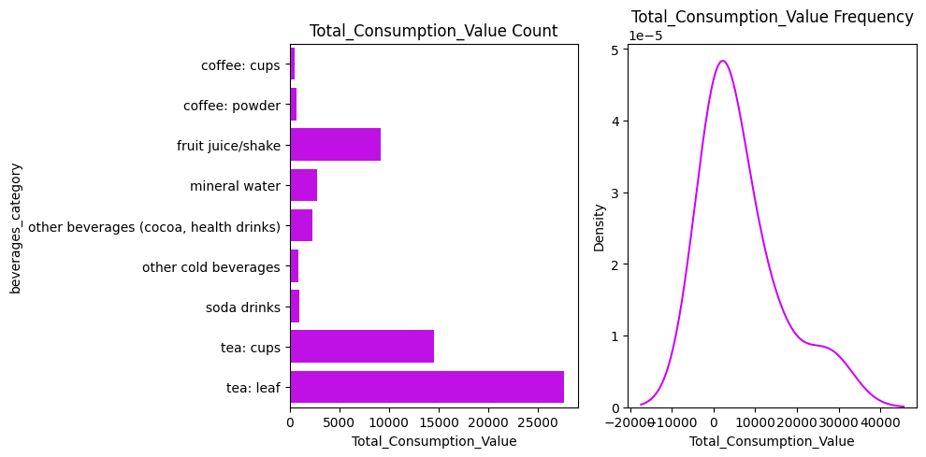
beverages Category Total value

Slide 14
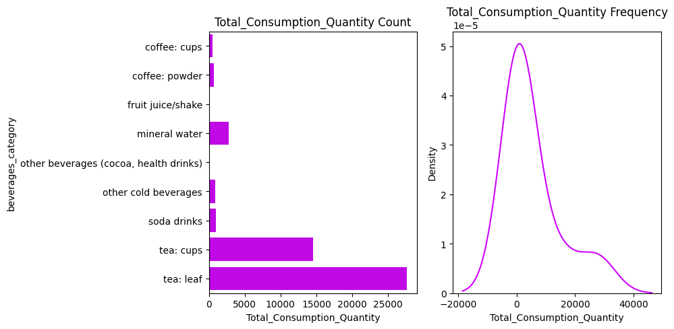
beverages Category Total quantity

Slide 15
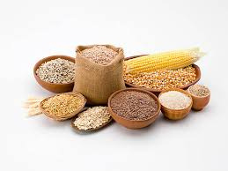
cereal

Slide 16
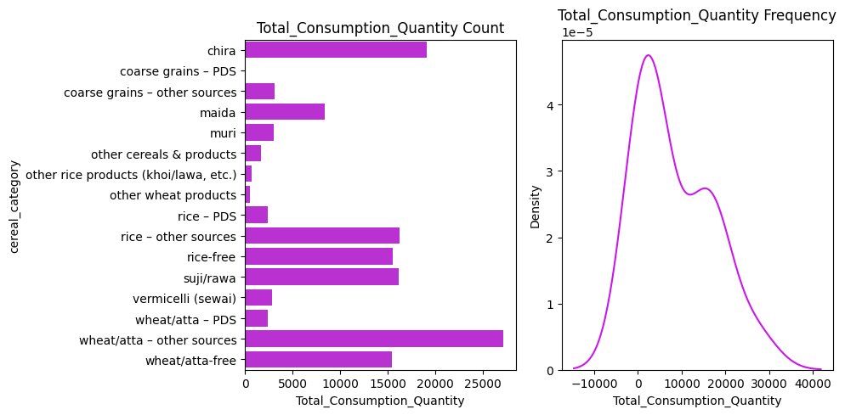
Total quantity

Slide 17
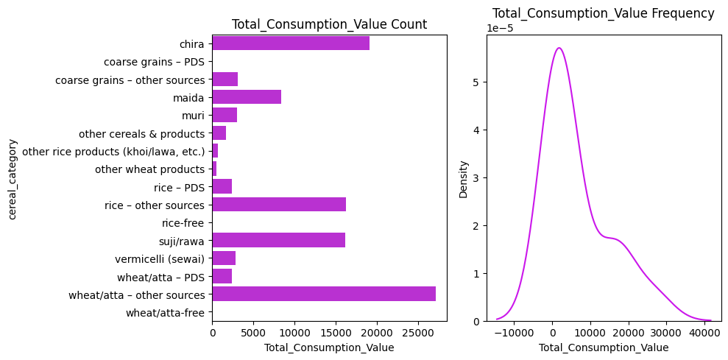
Total value

Slide 18
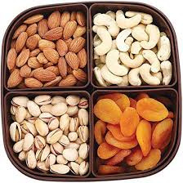
dry fruits

Slide 19
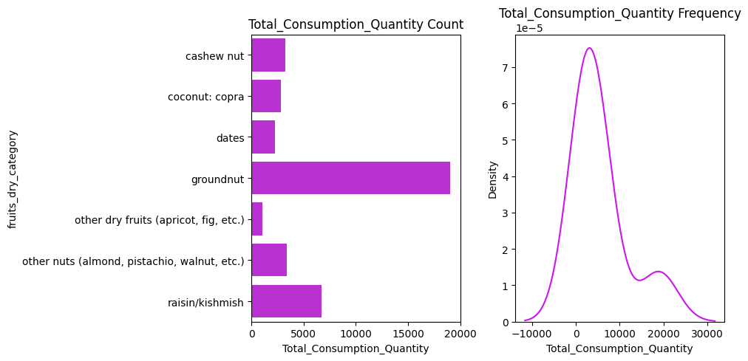
Total quantity

Slide 20

Total value

Slide 21

fresh fruits

Slide 22
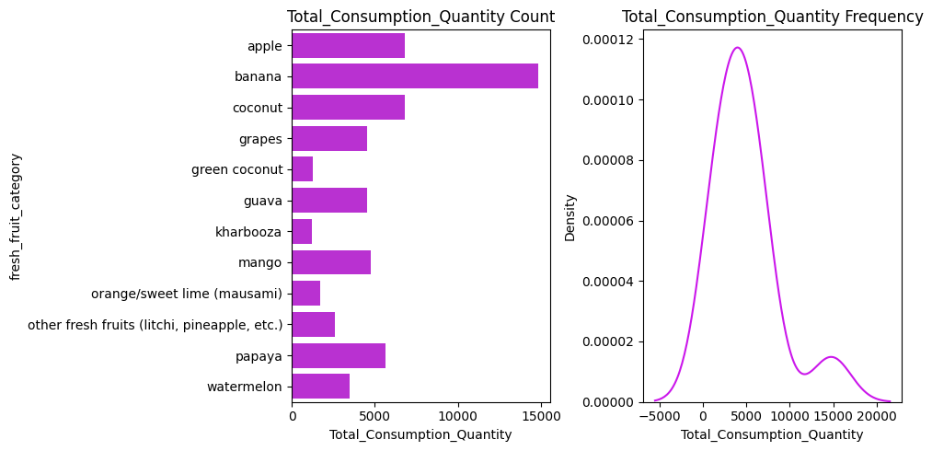
Total quantity

Slide 23

Total value

Slide 24
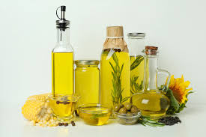
oil

Slide 25
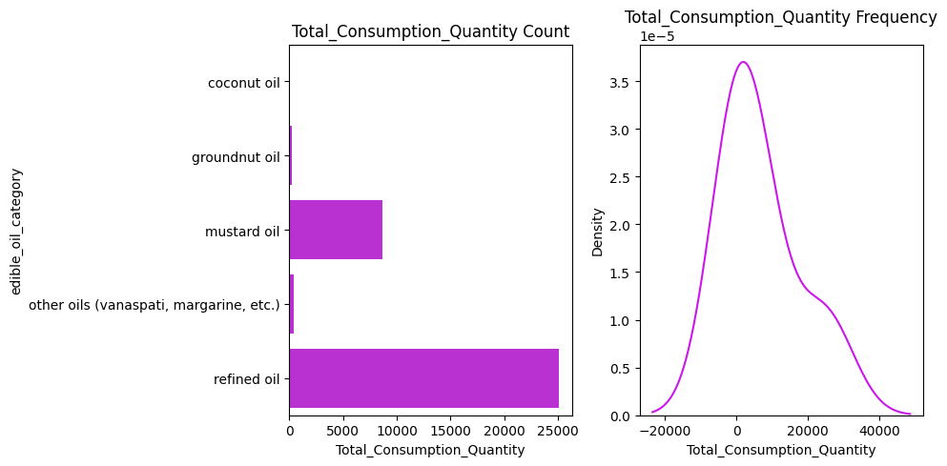
Total quantity

Slide 26
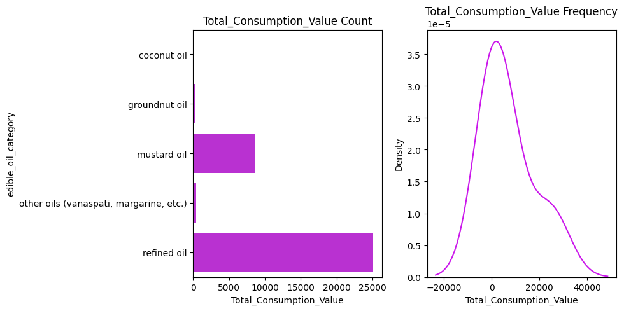
Total value

Slide 27
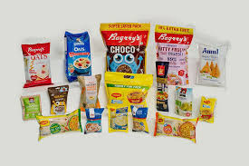
packaged food

Slide 28
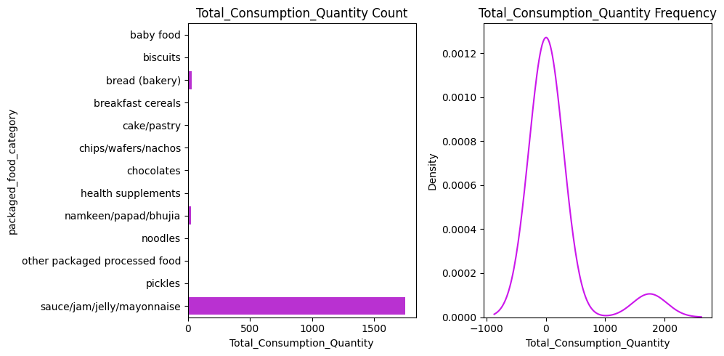
Total quantity

Slide 29
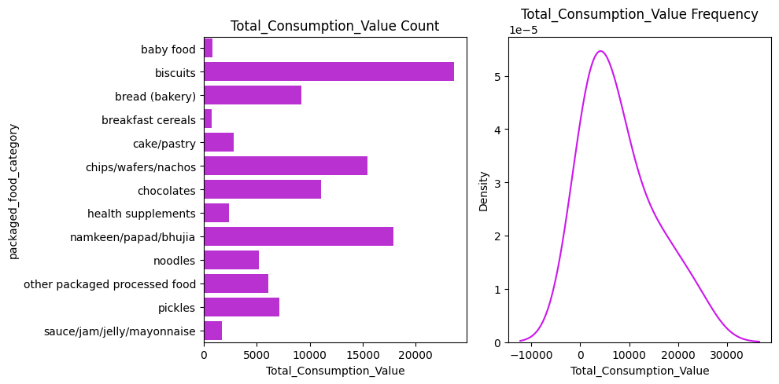
Total value

Slide 30
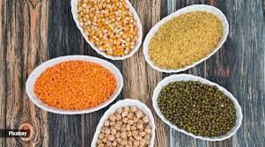
pules

Slide 31
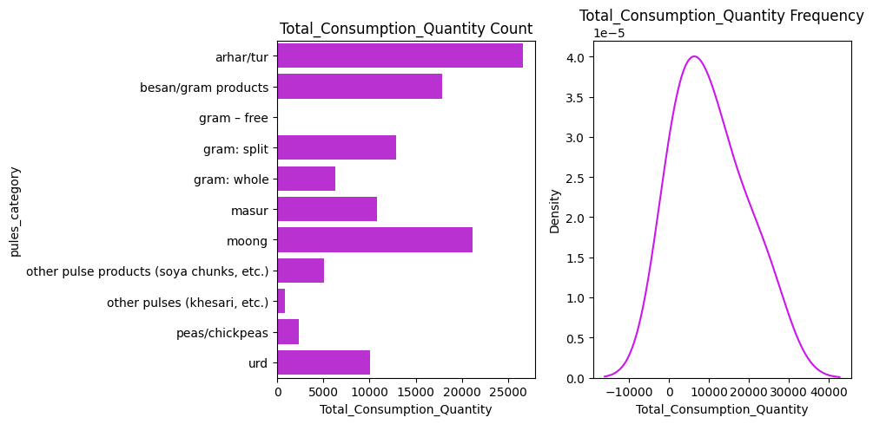
Total quantity

Slide 32

Total value

Slide 33

salt sugar

Slide 34
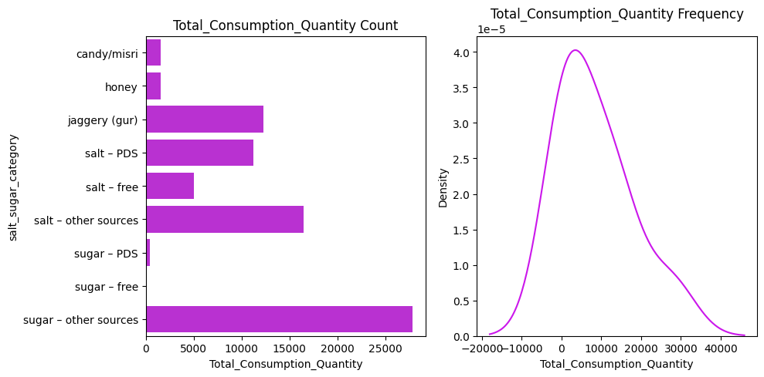
Total quantity

Slide 35
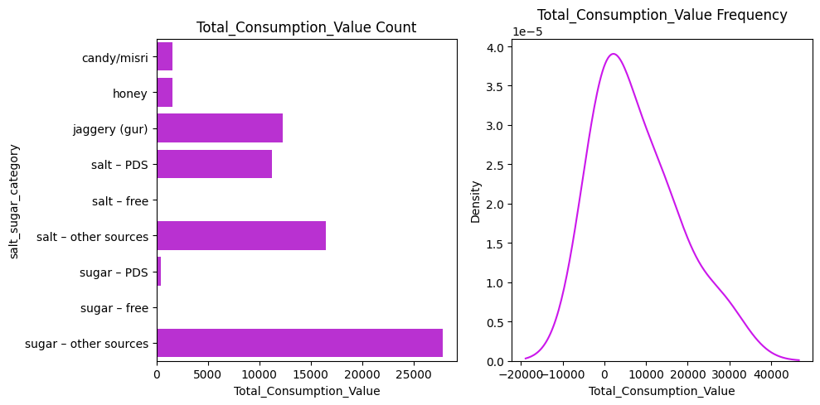
Total value

Slide 36
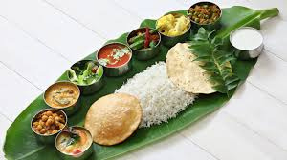
served food

Slide 37
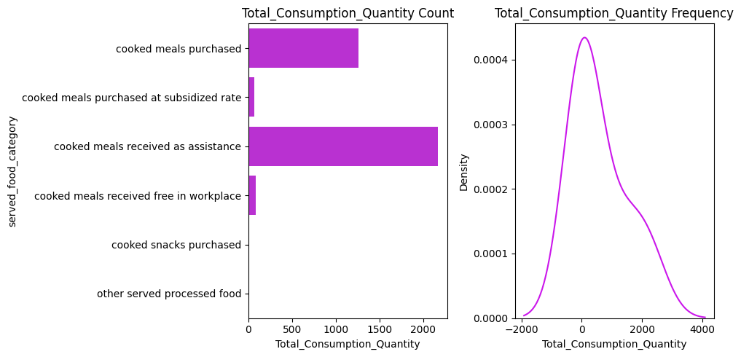
Total quantity

Slide 38
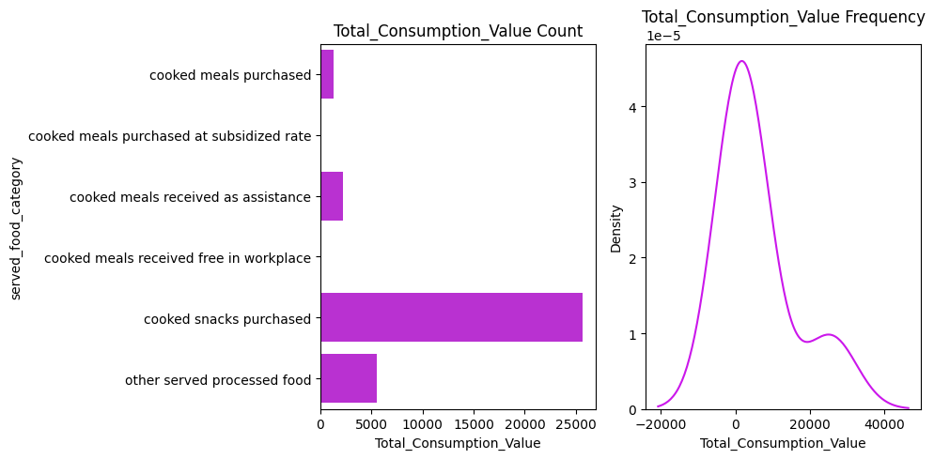
Total value

Slide 39
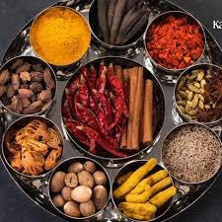
spices

Slide 40
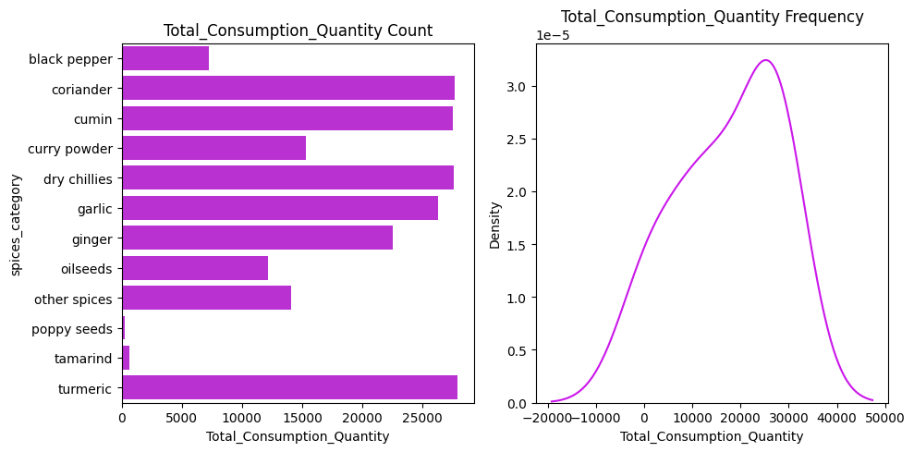
Total quantity

Slide 41
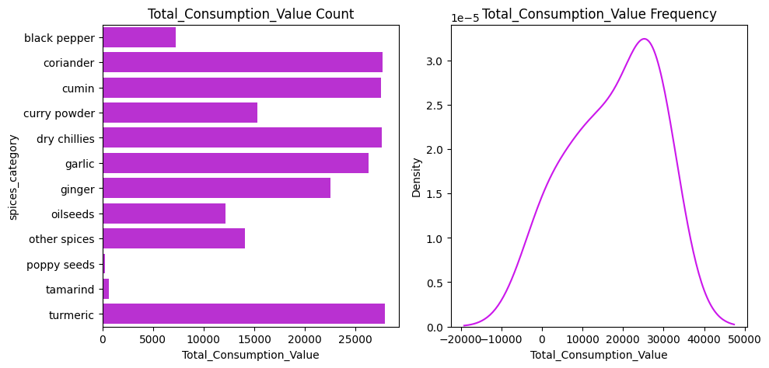
Total value

Slide 42
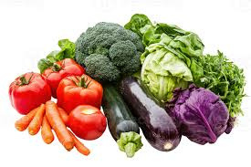
vegetables

Slide 43
table

Slide 44
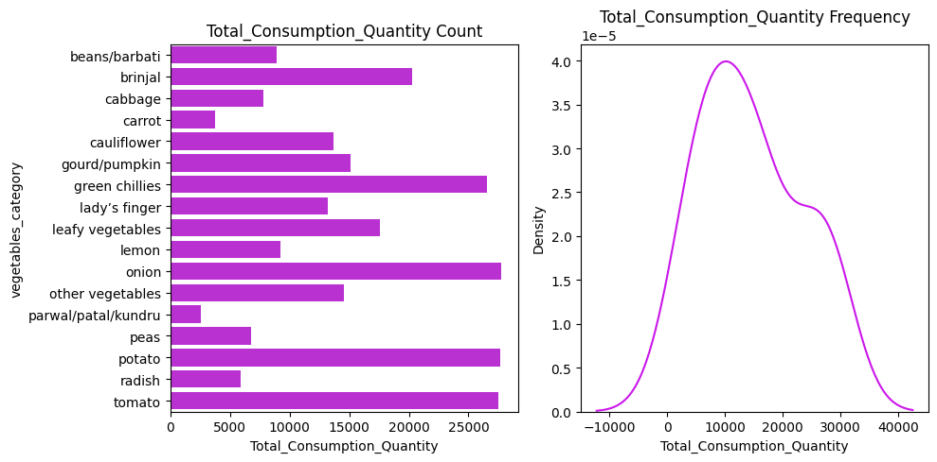
Total quantity

Slide 45

Total value

Slide 46


SOURCES
Notebook 05 05 Link
Notebook 06 05 Link
Mapping

Slide 47
thank you
RUDRA
PRASAD
BHUYAN

